Slide 1

Case Study 7.7: Capstone Project
By George Redden

Slide 2
Imagine a learning platform that combines comprehensive English courses with meaningful entertainment in the form of videos, readings and podcasts.
With Glossos, you can unlock powerful English guides to prepare at any level with enterntainment content that will boost your knowledge of culture, history, science and other key day-to-day topics.

Slide 3
Glossos
A meaningful way to learn languages

Slide 4

Problem: For students, in particular adults, learning English can be an uninspiring ordeal.
Most textbooks are designed for classroom activities goals in the long term. In addition, going from A1 level to C1 level requires buying several books and can take up to 8 years!
There are no complete grammar guides that follow a coherent learning curve. Also, most leave out the speaking, listening, writing and reading aspects of the language.
Most exercises found in English textbooks and in platforms online don’t reinforce the grammar and vocabulary learned in previous chapters.
English textbooks offer a poor introduction to the culture, history and key vocabulary of the English language. In addition, most vocabulary units are intended for young ages, leaving out crucial day-to-day vocabulary.
The preparation process for official exams can be quite frustrating. Most exam preparation books either don’t cover the necessary grammar or fail to streamline the concepts and vocabulary require to pass the exam. As a result, students are forced to buy or seek for extra material.

Slide 5



While English academies don’t offer courses specifically for adults, there are business classes or expensive 1-to-1 lessons.
Online apps like Duolingo offer a learning platform designed to learn by repeating and writing common expressions.
Complete grammar textbooks that leave out key aspects of the learning process.
Online apps that offer translations or subtitles for books, films and tv shows.
Documentary platforms like ARTE and Curiosity Stream that provide educational content without offering any learning materials or modules.
Current
Solutions

Slide 6
Why these solutions don’t work:
Where do teachers for 1-to-1 tutor lessons get their teaching material from? At best, they will find relevant exercises from different sources, but the student will inevitably feel like the material is disjointed and would like to have access to a platform where all the content is prepared and organized.
Adult learners tend to set their own time-spans according to their needs. Most adult learners are focused on achieving their objectives and learning skills that can be implemented on their daily lives. There is not a single guide on the internet that provides a holistic approach to students to learn the English language.
It’s frustrating for students not to have a seamless guide that follows the traditional educational method of learning by following. Most books and guides force students to waste time studying and wondering what they are doing wrong. The objective is to have an all-encompassing manual that guides students step-by-step through the learning curve of mastering English.
Online apps that offer translations for books or subtitles for films can be entertaining for students. However, they leave out the grammar, writing and other fundamental skills that many adults require in their daily lives. In addition, apps like Duolingo only work to reinforce basic concepts or introduce students to the language. Intermediate and advanced students require more diverse excersises and material to fully grasp what they are learning.
Adults learners expect to learn vocabulary related to their field of study or useful in their daily lives. Currently, there are no apps or textbooks that properly introduce expressions, vocabulary and real conversations and dialogues to students. In addition, most learning material offers bland, unispiring content that fails to capture and offer a meaningful content to students.

Slide 7
The Solution:
An English language online portal that covers all the key aspects of the language (grammar, reading, listening, vocabulary, speaking and writing) providing students with standardized material and exercises that can enhance not only their preparation for official language exams, but also streamlines and speeds up the learning curve.
How it will work:
A monthly subscription model to access the website.
It will come with the option to receive a textbook for those who preferred more traditional methods.
The guide will offer a clear pathway of progression from beginner to advanced level.
Each unit will contain a grammar lesson with exercises along with vocabulary about a key topic, with reading, listening, writing and speaking exercises to reinforce the learning experience.
The website will also regularly and media in the form of readings, listenings, video recordings and podcasts that promote students to remain engaged with the website.

Slide 8
What makes us different from other learning platforms?
The main difference that our platform will offer is that it will combine an all ecompassing guide to learn English similar to what science platforms like Brilliant offer at the moment with entertaining video and reading content that can make the learning process more relevant and meaningful to the student’s life. Thus, the goal is that students advance their English skills at a fast pace while keeping them engaged with the platform through the entertainment and educational content provided by the videos, readings, podcasts and other learning material. It would be like combining Brilliant.org with other platforms that teach English through videos or stories.
The platform will provide a complete and progressive guide of the language. It will improve the current traditional format of student books by instead offering a guide with clear explanations about every grammatical rule with its exceptions. Students will learn first through easy explanations and then put their acquired knowledge into practice. This would work more like a manual or like an apprenticeship method, whereby students copy what they see until they feel comfortable with the material.
Currently, there are no complete grammar guides available in one platform. Only student books for different levels (A1 to C2 for example) Thus, when students advance to a different level, they find that the next book is done by a different author with a completely different format and methodology. This can throw off and discourage the student’s appetite for learning as the process can feel disjointed.
The platform will combine the more traditional grammar material with listenings and readings about relevant topics with a focus on elevating the student’s knowledge of culture, history, science, business and other day-to-day topics.
Preparations for the Cambridge B1, B2 and C1 level exams will be streamlined, there will be lessons and exercises designed to explain what will be tested and how to prepare for the exam. Also, exam practice questions will be organized by grammar topic so that students can easily go back and forth. Students will no longer feel like the exam questions being asked haven’t been covered in the material.

Slide 9

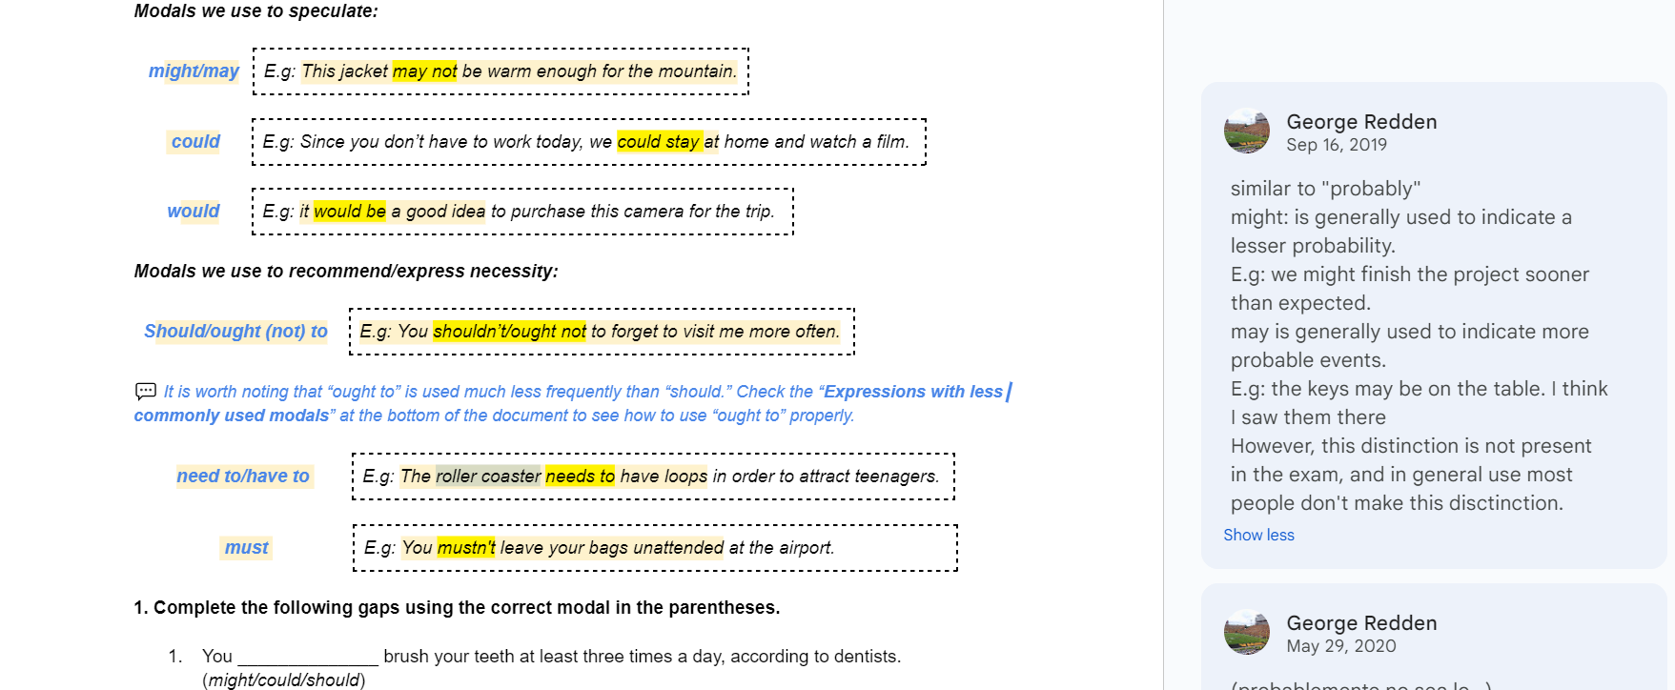




Product Demo:
Students click on the key words in the unit to get a detailed explanation of the concepts.
How the grammar units are covered in the guide:
The grammar is first explained with clear examples. The highlighted words help students memorize the format.
Notes containing info about usage and exceptions add detail and depth to the concepts learned.
Students can click on key vocabulary words to get a definition and translation.
For exam takers, the comments will provide useful tips so that students feel more prepared.,

Slide 10
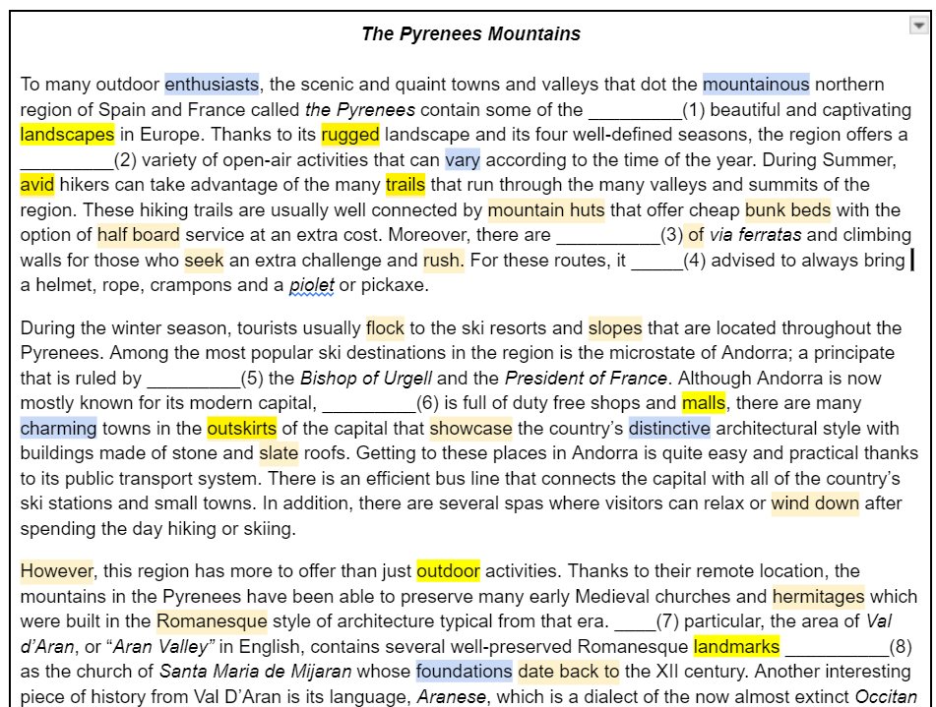
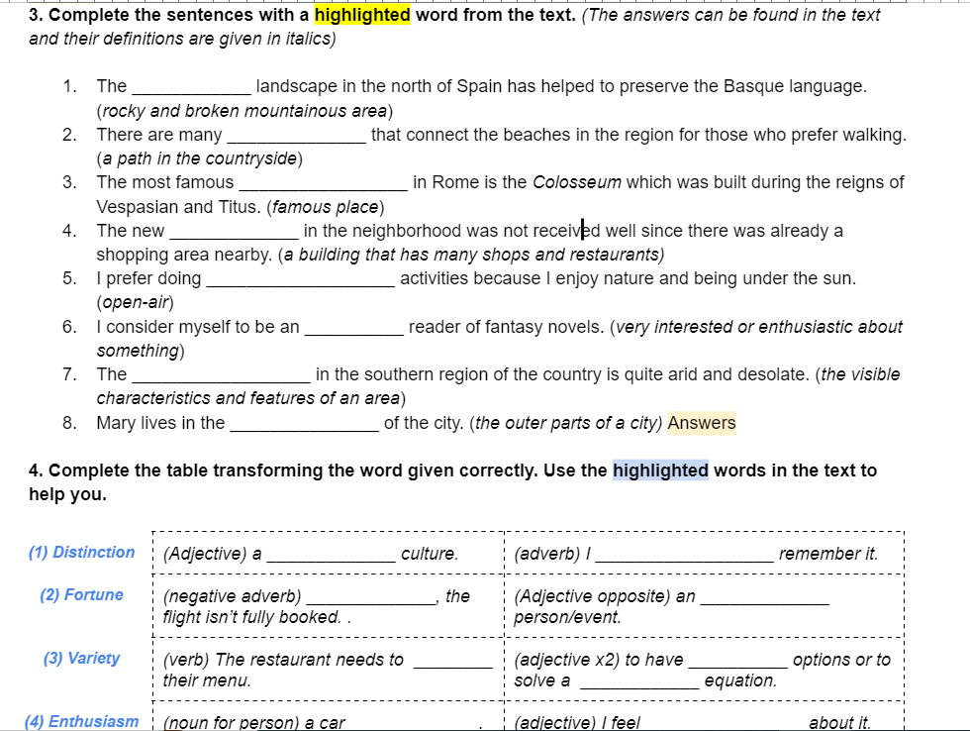
Covered topics will be relevant to a wider audience, drawing from the success of educational YouTube channels.
Product Demo:
How reading exercises are covered in the guide:
Key vocabulary from the topic will be reinforced through practical exercises.
Throughout the guide, users will be able to click on relevant vocabulary like connectors to quickly learn or refresh their meaning to that they are not forgotten.
Word transformation will be made easy, by not only adding context, but also organized examples from each topic.

Slide 11
Market Sizing
In Spain, the edTech market is reaching maturity with many educational institutions offering language-learning courses. Nevertheless, the CAGR from 2023 to 2028 is still expected to be 3.22%. Conversely, in LATAM the CAGR is expected to be 20% representing an increase in the market from approximately $4Bn to $10Bn by 2028. After the Covid-19 pandemic the market has quickly expanded with more students requesting access to online learning. In Spain, the demand for students seeking to learn English remains quite high, with many students feeling frustrated with the current methods available. In addition, Spain currently ranks 33rd in the EF Proficiency Index, making it one of the lowest ranked countries among developed nations. (Meneses 2023)
$54.7Bn
$10.7bn
$0.4Bn
The TAM for global English language learning is $54.7Bn with a CAGR of 10.27%
The SAM for online learning platforms in LATAM and Spain was $10.7Bn in 2022.
The SOM for online learning platforms in Spain for 2024 is $0.421 with a CAGR of 3.22%
Source : LinkedIn. 2022
Source : Forbes & Statista
Source : Statista

Slide 12
Market on Map
$1.4bn
$7.3Bn

Slide 13

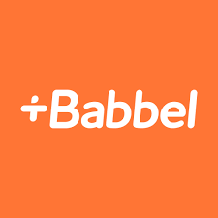
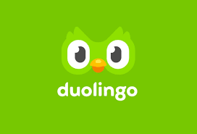


The Competitive Landscape
For prospect students in Spain and LATAM, there are currently no equivalent learning platforms. Most edTech platforms are provided by universities or educational institutions with the aim of learning an official certification. The problem with these platforms is that these courses are designed to learn the language at an extremely slow pace, with a certification for each level taking approximately one full academic year. In addition, their content only caters to full-time students, which can render the course uninteresting to those outside the educational world.
The closest available online platform at the moment is the British Council portal through the University of Cambridge. Monthly costs are £5.99 per month to have access to exercises that cover the skills you want to improve. However, this membership does not include a thorough guide of the grammar. Listening, viewing and reading material is mostly aimed at young audiences with very little choice of topics. In addition, this membership does not officially prepare the student for any type of official examination.
There are exam practice websites that prepare students for official TOEFL, Oxford, or Cambridge examinations. However, these websites only offer exam samples and content related to these exams. In addition, none of them offer additional media content to keep the students engaged.
None of these platforms currently meet all of these criteria:
-Combine a comprehensive grammar and vocabulary guide with enterntaining media like videos or podcasts.
-Provide detailed preparation for Cambridge certification exams.
-Combine all the aspects of the language (grammar, vocabulary, reading, and writing) into one seamless learning curve experience.
Most popular learning English platforms online:

Slide 14
Revenue and operating models:
$15.99/Month
$9.99 /Month
$500.00
Operating Model:
The company will have a subcription model whereby customers can choose from 3 different plans. The yearly plan will be recommended to potential customers. Also, a textbook format of the gramar will be offered at a price of $39.99 for those preferring a more traditional method of learning. In addition, the company will strive to enhance its presence on social media channels like YouTube, Instagram and TikTok, so that both marketing and customer acquisition costs can be reduced.
Monthly
Yearly
Lifetime
$39.99
Other future possible sources of income in the pipeline:
- Tier membership system aking to Patreon to access media.
- Revenues from social media content.
Cost of textbook

Slide 15
Forecast & Projections
Scenarios based on a 2-year period:
Best Case Scenario
- Company becomes market leader, $40+ million revenues per year with 3 to 4 million users per year. (10% of the market share)
Realistic Success Scenario
- Company captures 1% of the learning platforms in Spain and LATAM achieving $1.8 million in revenues per year. (Between 100 to 200 thousand users per year)
Worst Case Scenario
- Company captures a small niche market with between 25 to 50 thousand users per year. Yearly revenues amount to $500 to 600 thousand per year.

Slide 16
Split Budget
Initial investment is expected to be $107,000.
The objective of the company is to run an asset-light operation with main expenditures going towards the design of the portal and marketing expenses.
Salary expenses are based on projections from average salaries in Spain.
Other expenses include office leasing, permits and quality control.
Most of the new hiring will go towards creating a media department in charge of creating videos, readings and other material.
Since the English guide and most basic learning content is ready, the company will not have to invest much on the creation of English learning material.

Slide 17

Founders
Caroline Mortel
George Redden
Aaron Goertz
EDHEC Universityt

Slide 18
Funding Request
$500,000
$200,000
Post money valuation:
$2,500,000
At 20% to fund the first year of operations.
Cash available at the moment for investing
Expenses | Month 1 | Month 2 | Month 3 | Month 6 | Month 9 | Month 12
Cost of building E-learning platform | $ 40,000 | - | - | - | - | -
Salary Expenses | $ 12,000 | $12,000 | $12,000 | $18,000 | $18,000 | $36,008
Marketing expenses | $ 50,000 | $40,000 | $40,000 | $60,000 | $60,000 | $60,000
Other expenses | $ 8,000 | $ 8,000 | $ 8,000 | $16,000 | $16,000 | $18,000
Website maintenance expenses | - | $4,000 | $4,000 | $5,200 | $5,200 | $6,800
Total | $ 110,000 | $ 64,000 | $ 64,000 | $ 99,200 | $ 99,200 | $ 120,808

Slide 19

How the fundraising will advance the business:
The main purpose of the fundraising is to obtain the necessary funds to create a user-friendly platform that allows students to easily keep engaged with the content.
The funding will also go towards covering CAC costs through marketing on social media.
In addition, funds will be allocated to create a media department in charge of producing meaningful videos, listenings, podcasts and other material to keep users engaged.
Finally, the funding will go towards setting the business up and covering montly operational costs.
$25.63
Expected CAC for year 1
(Sales & Marketing costs) $1,025,200
(Number of expected Users)
40,000
Although the company intends to run an asset light operation with very few fixed costs, most of the CAC expenses will come from marketing costs on social media and content creator costs.
$21
Average acquisition cost in the Arts & Enterntainment. Source: Twilio 2024

Slide 20
References
LinkedIn. 2022 “English Language Learning Market | Staying Up to Date with New Development Plans for 2031.” https://www.linkedin.com/pulse/english-language-learning-market-staying-up-date-2rf0c/?published=t
Forbes. 2023. https://forbes.co/2023/01/16/red-forbes/como-la-tecnologia-esta-transformando-la-educacion-en-latinoamerica
Statista. 2023 https://www.statista.com/outlook/dmo/eservices/online-education/spain#:~:text=The%20revenue%20in%20the%20Online,US%241%2C762.00m%20by%202028.
Meneses 2023. El País. “¿Por qué cuesta tanto aprender inglés?” https://elpais.com/economia/formacion/2023-07-13/por-que-sigue-costando-tanto-aprender-ingles.html

